Slide 1
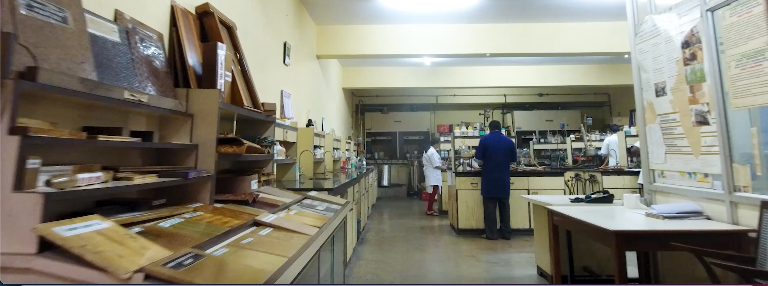
Research Needs in Bamboo Sector
Dr B N Mohanty, IFS ®
Ex PCCF, Manipur,
Ex Director, IPIRTI,
Bengaluru

Slide 2
Innovation is the Key: Eureka
Sci-Tech Innovation
Greater market demand for innovations
Ever-expanding team of innovators
Michael Porter (1990), in globalisation era,
Locational Advantages (raw material, cheap labour) —less relevant.
Competitive advantage— (productive use of inputs)
Continual innovations —is the winner
More innovations likely in communities having stronger inter-personal networks

Slide 3
Quick Recap…
Research Outputs so far…
(Since mid fifties…)

Slide 4
AVAILABLE BAMBOO TECHNOLOGIES
Gen 1: BAMBOO MAT BASED
BAMBOO MAT BOARD (BMB) (1985)
BAMBOO MAT CORRUGATED SHEETS (BMCS) (2002)
BAMBOO MAT RIDGE CAP (BMRC)
BAMBOO MAT MOULDED SKIN BOARD (BMMSB)
Gen 2: BAMBOO STRIP BASED (2011)
BAMBOO HORIZONTAL LAMINATES
BAMBOO VERTICAL LAMINATES
Gen 3: Bamboo Strand Lumber/Scrimber
(2014)
Miscellaneous Tools
ANCILLARY BAMBOO PRODUCTS
BAMBOO BASED HOUSING SYSTEM
Year of commercialisation

Slide 5
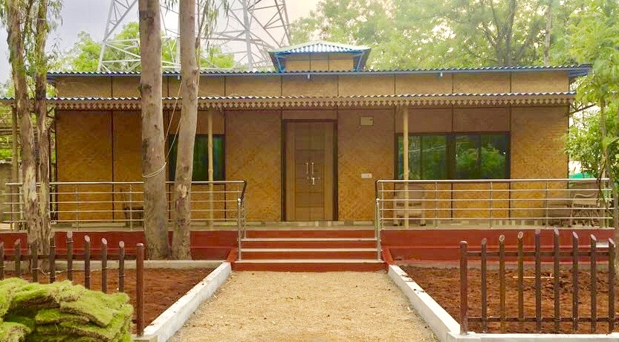
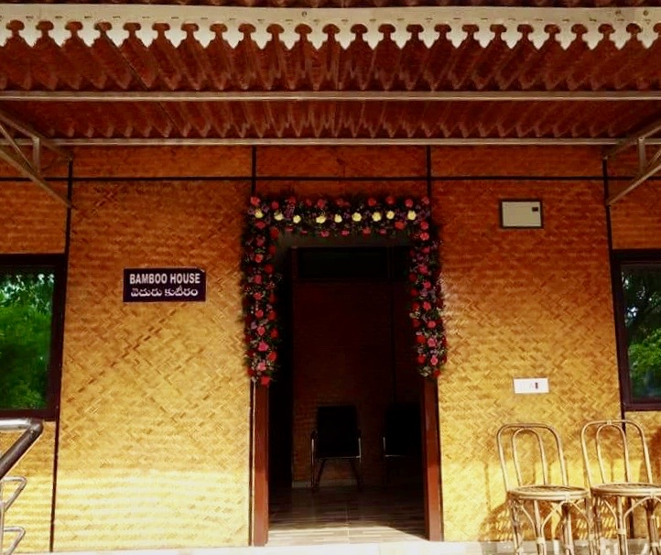
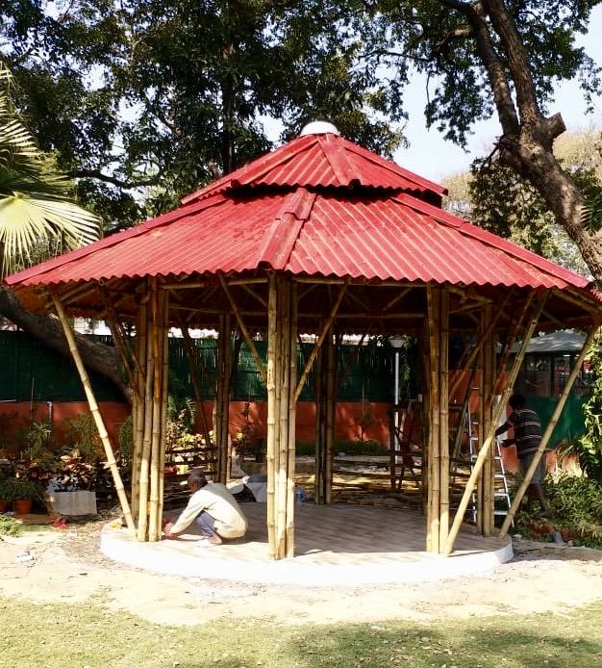
PRE-FAB HOUSES WITH BMB, BMCS & BMRC
Prefab Bamboo House, Hyderabad
Prefab Bamboo Solar Hut, Delhi

Slide 6
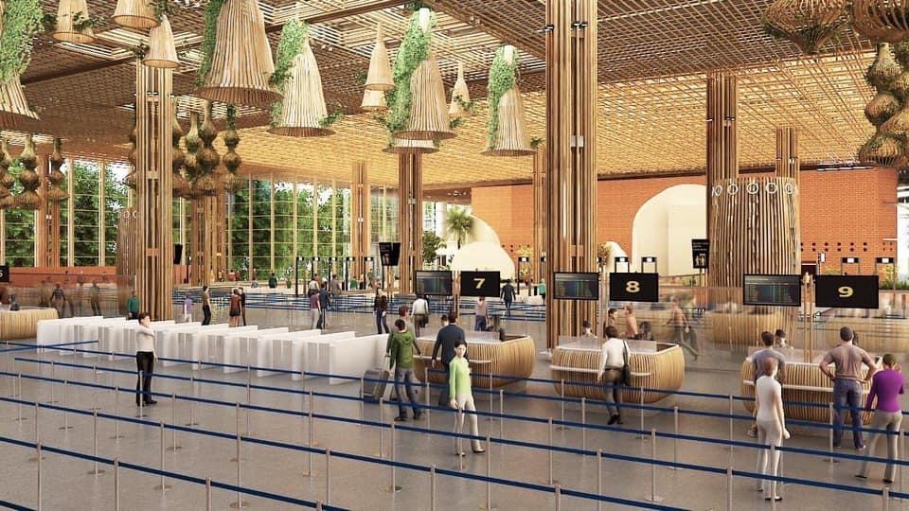
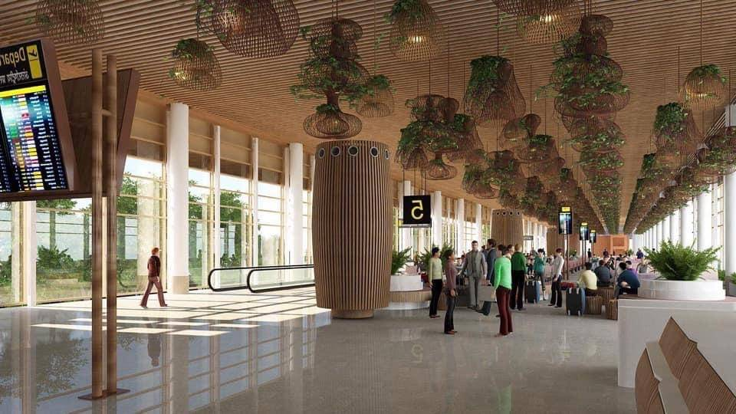
INTERIOR BENGALURU T2: Bamboo Laminates
Courtesy:
DASSO Group

Slide 7
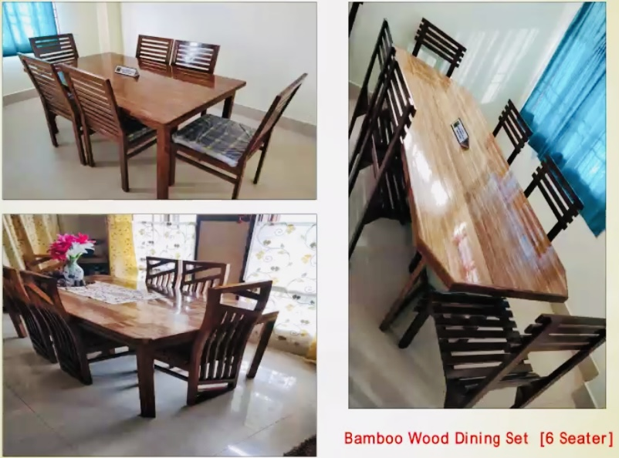
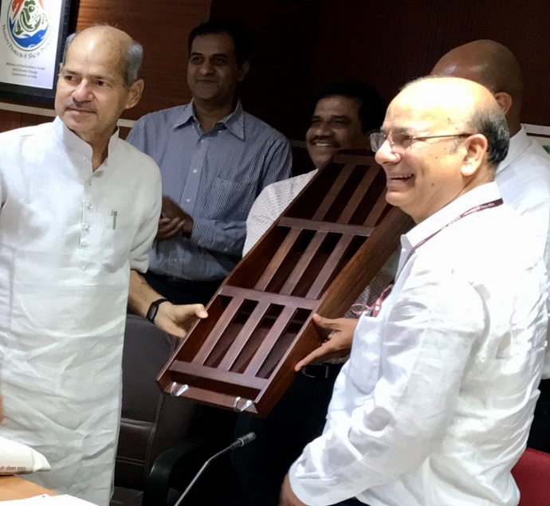
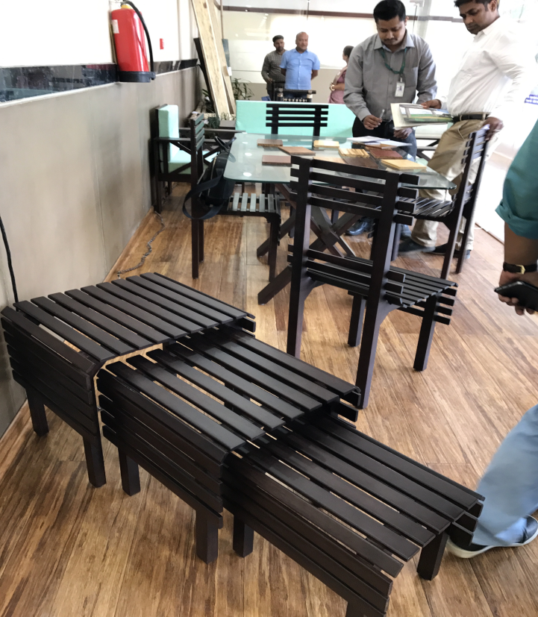
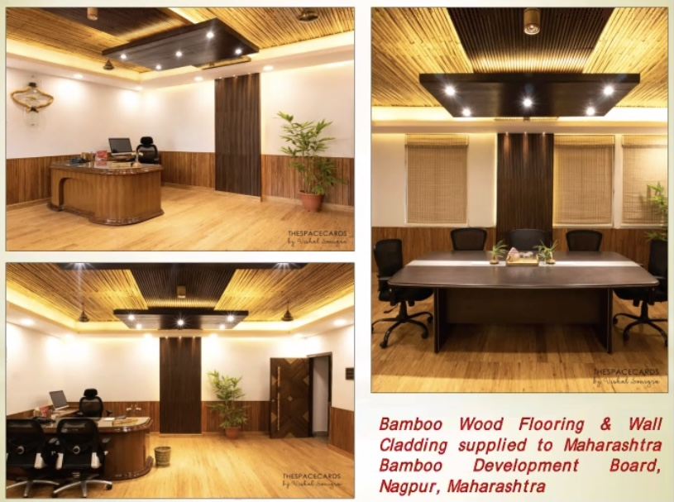
FORWARD LINKAGES of Bamboo lumber

Slide 8
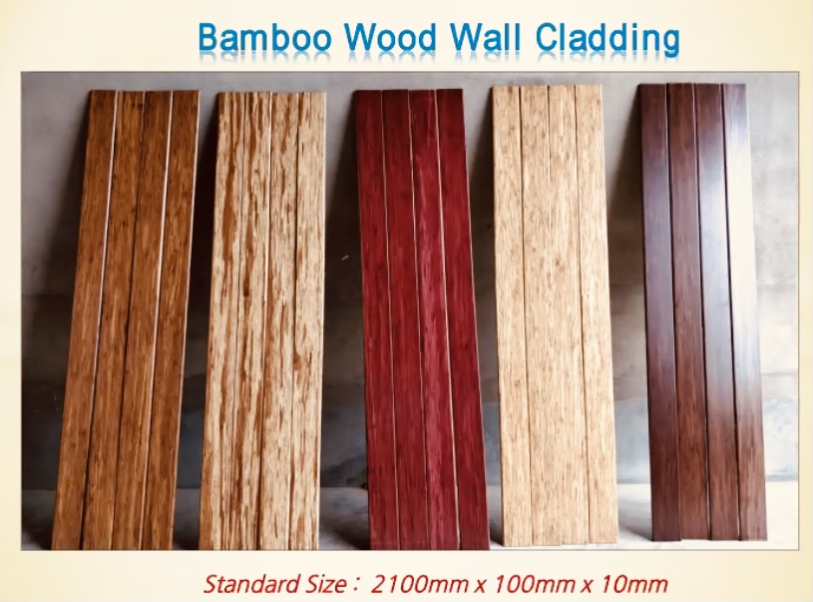
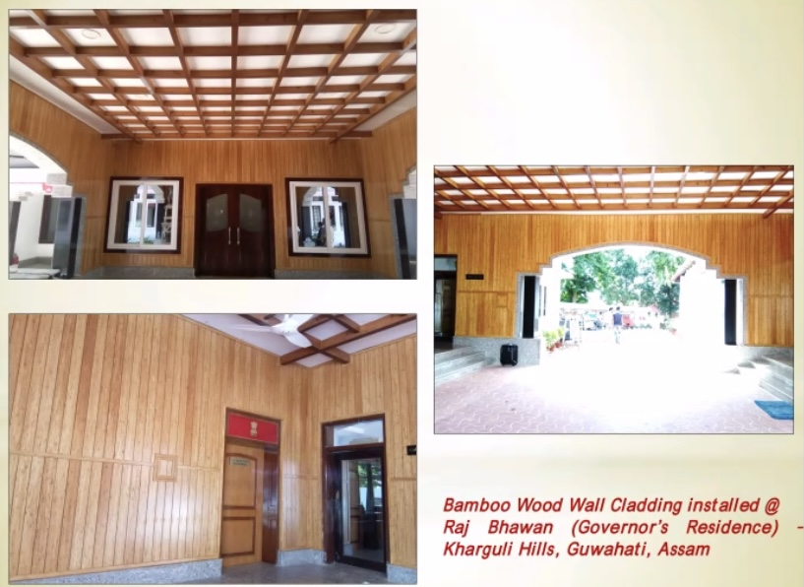
Bamboo Lumber/Wood

Slide 9
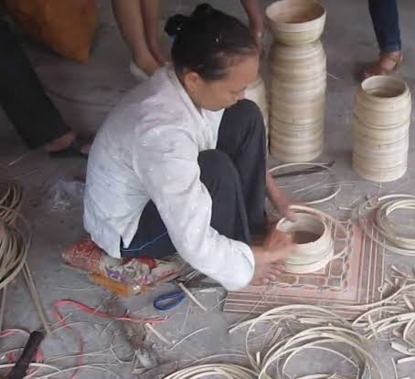
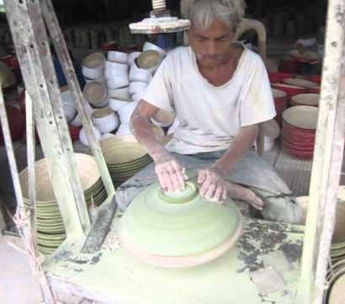
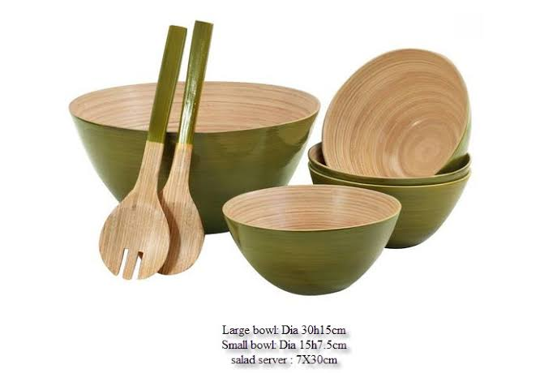
Coiled Bamboo Appliances
First derived from Vietnam
1-mm slivers are first curved on a roller & held tightly
Put over another 3-D mold for eventual form & glue applied on both sides

Slide 10
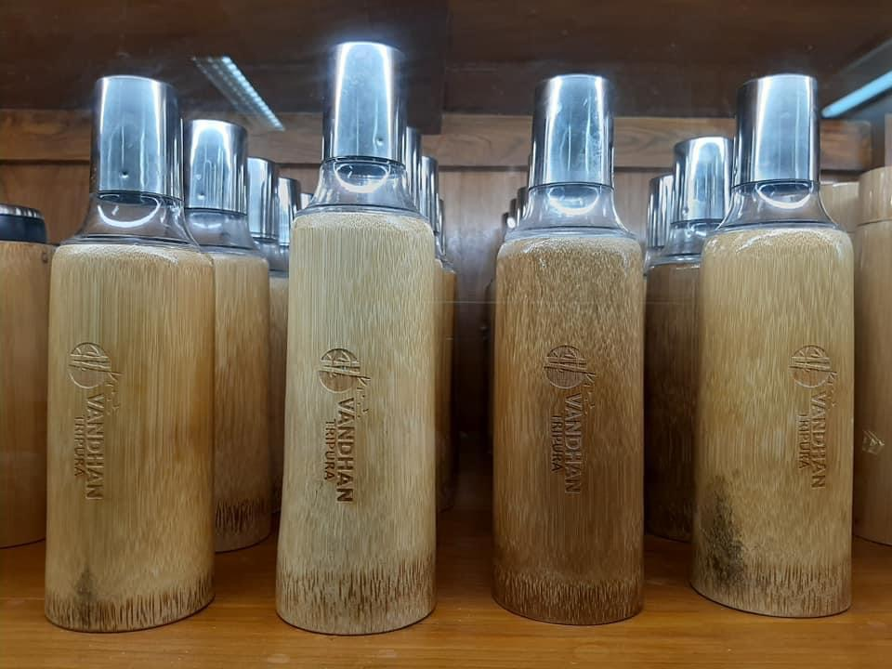
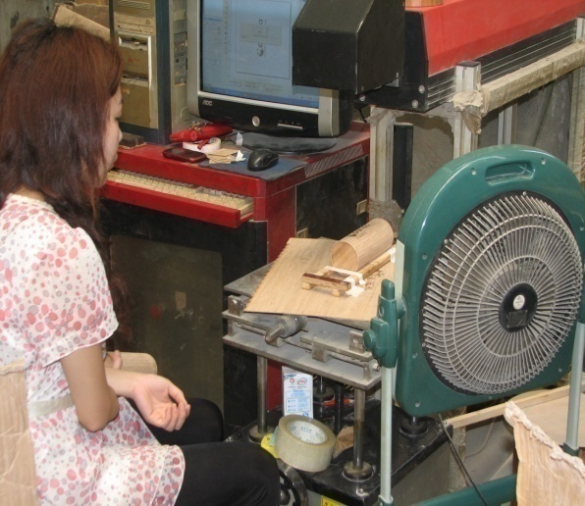
Bamboo Artefacts
L
A
S
E
R
P
R
I
N
T
I
N
G
Bamboo Bottles by
Mr. Prasad Rao, IFS (Tripura)

Slide 11
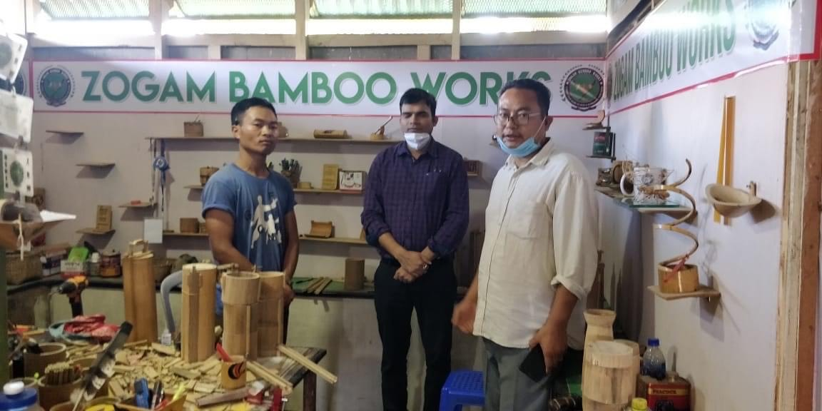
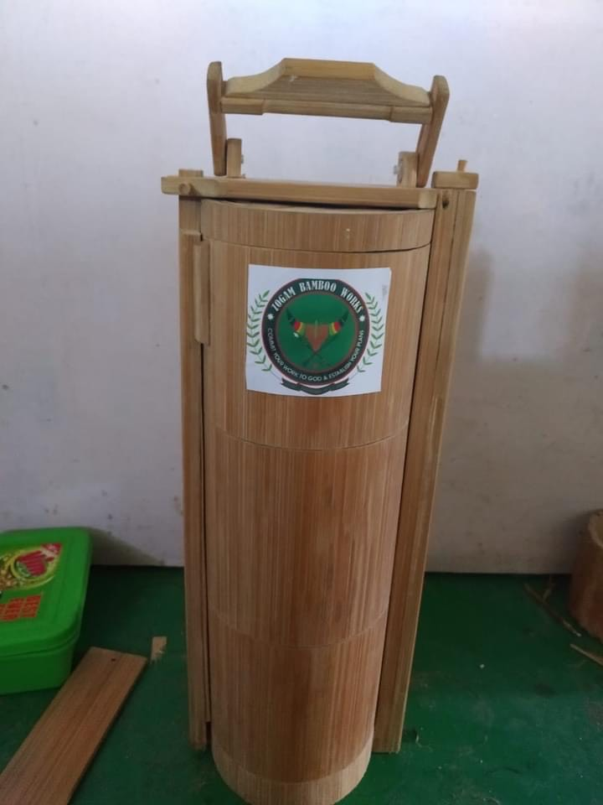
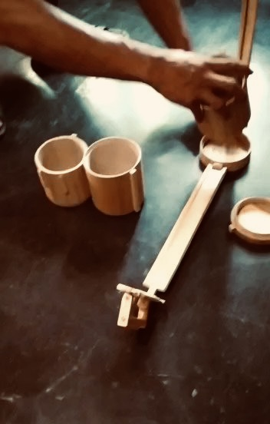
(Lockdown Innovations)
Bamboo Tiffin Box

Slide 12
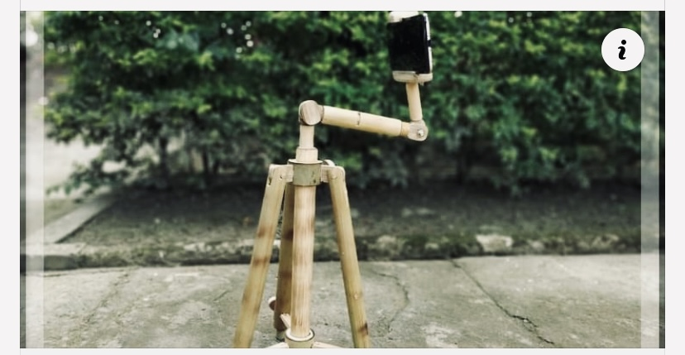
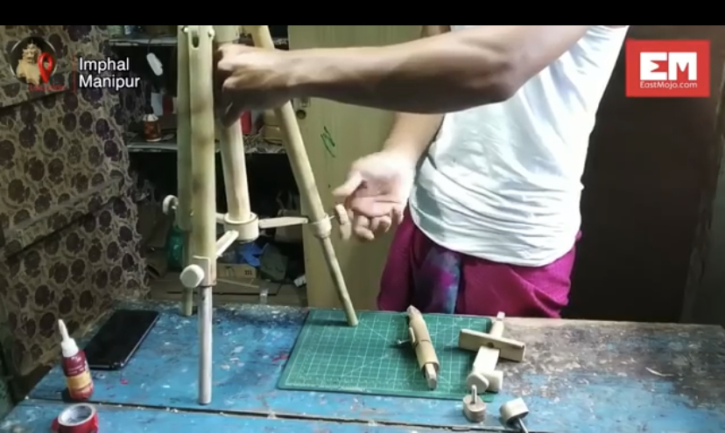
Bamboo Tripod
(Romesh Konsam)

Slide 13
Research Needs Ahead…
For challenges of 21st Century

Slide 14
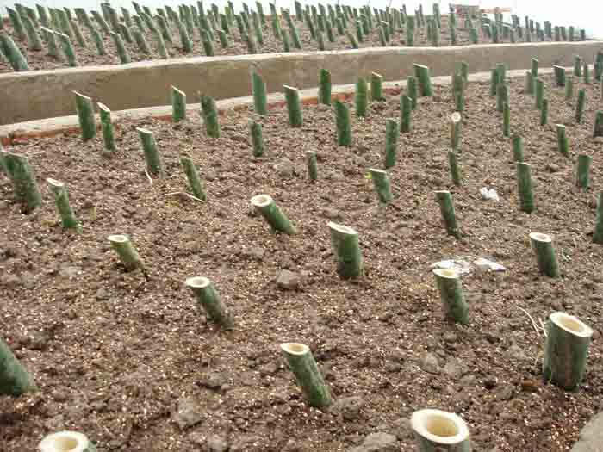
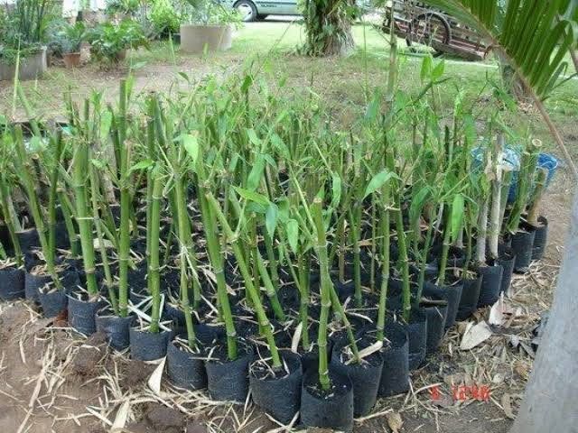
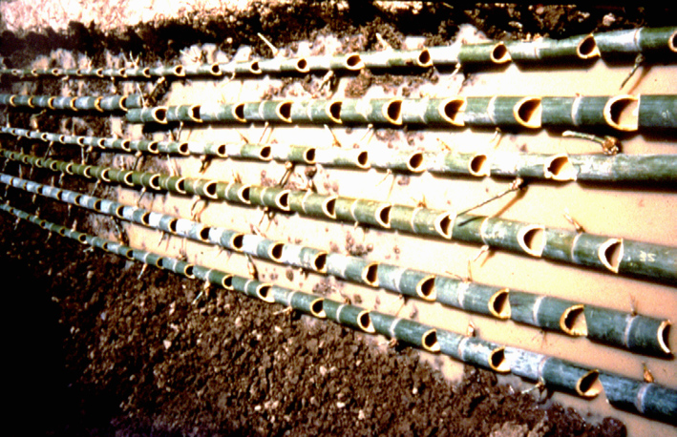
Bamboo Cultivation: Gaps & Issues
Multi site bamboo development & multi-factor intensive management
High Yield model short rotation bamboo
High quality, high yielding, high efficiency: timber, shoot & pulp forest
Work on stand density, diameter level & age composition
Weeding & scarification, Fertilisation, Pest control, Shoot protection
Rapid propagation techniques
(Hybrid rice solved food shortage, Bamboo technology to address poverty issues)

Slide 15
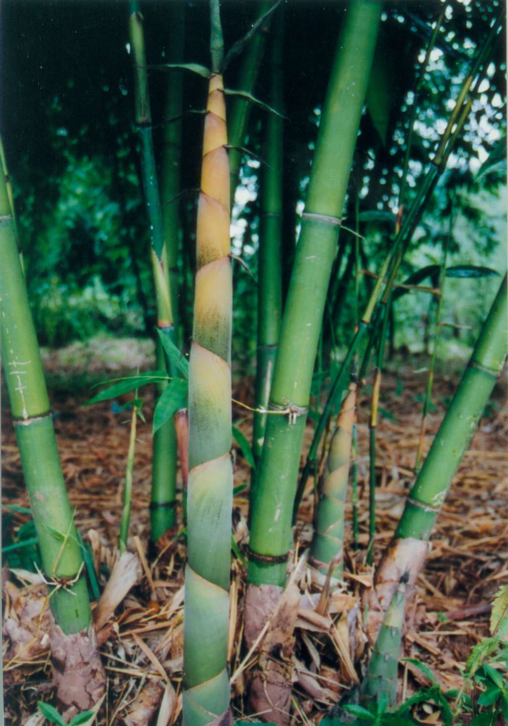
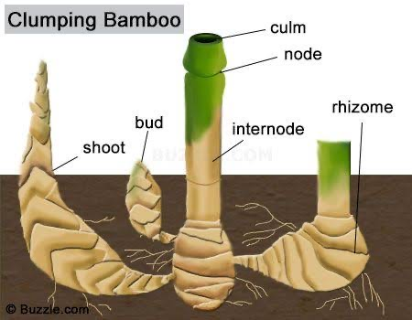
Sympodial Bamboo Cultivation
Diversity Assessment of Bamboo species
Investigation on plant diseases, insect & pests
Forest productivity recovery technology
Physiological determination of resistance
Post-disaster bamboo cultivation

Slide 16
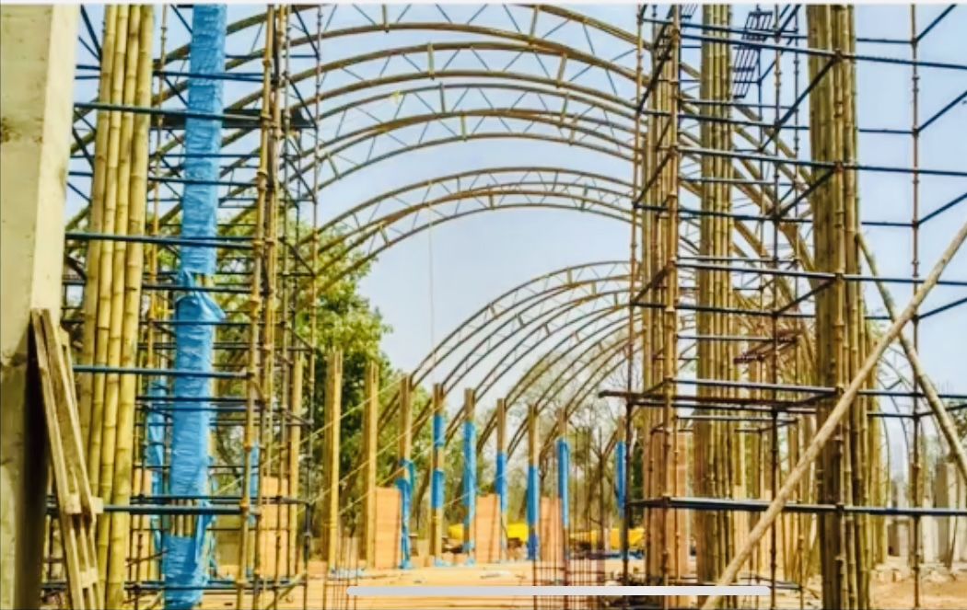
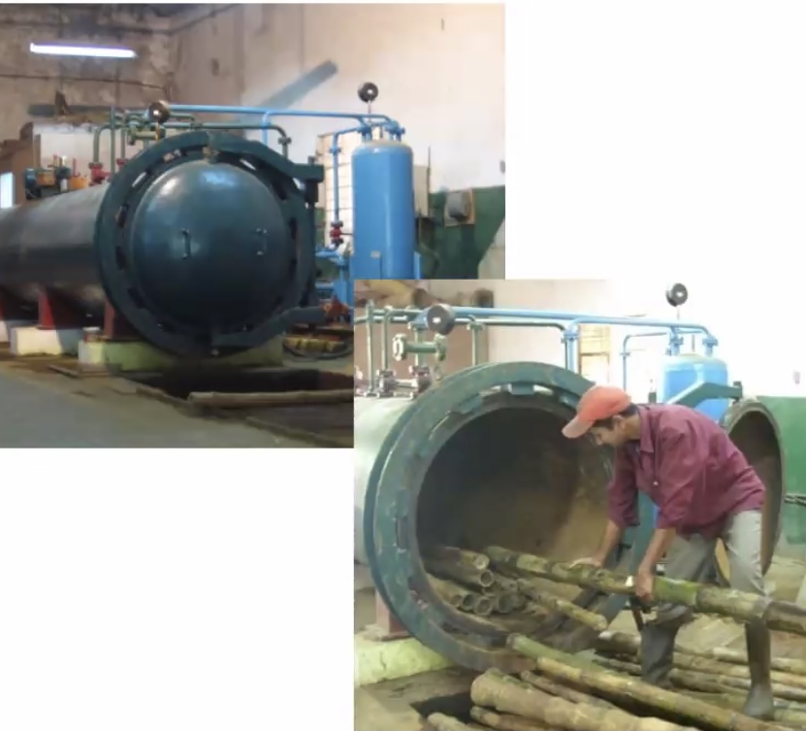
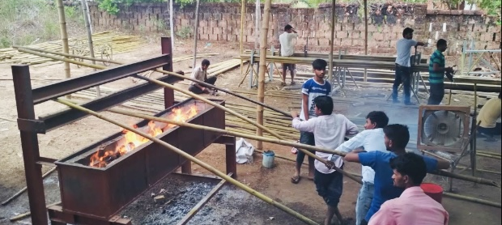
Pre-Processing Research
Mildew & Pest Control
Reduce Raw Bamboo Use & Strip Weaving
High Temperature Softening & Flattening

Slide 17
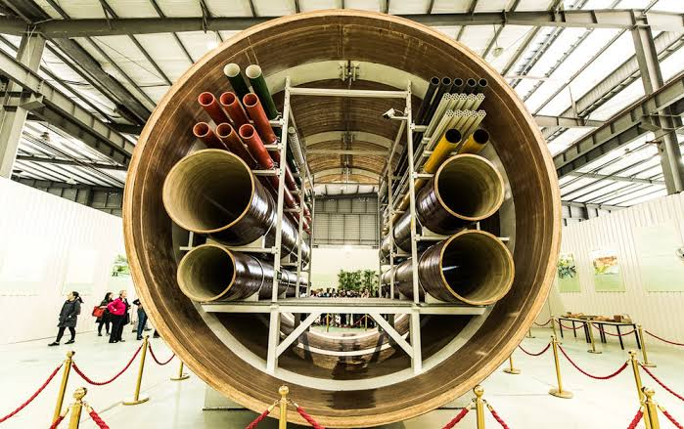
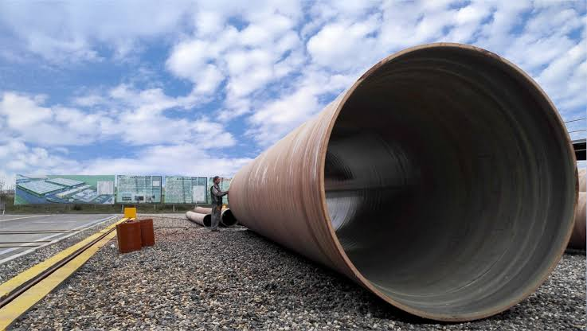
Cutting Edge Technologies
Bamboo –flame-retardant technology
Decay resistant strand woven bamboo
Water resistant heavy load bamboo-wood composite
Weather resistant bamboo decoration material
Mildew proofing chopping board
Bamboo Winding Composite Pipes

Slide 18
Bamboo Carbon Research
Carbon sequestration capacity of Bamboo
Carbon monitoring & carbon sink capacity enhancement
Integration of bamboo forest carbon sink in domestic & international trading
Development of bamboo carbon sink industry

Slide 19
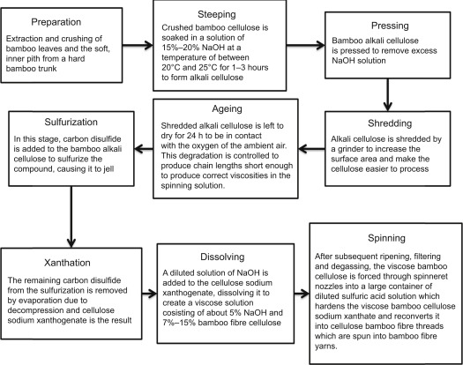
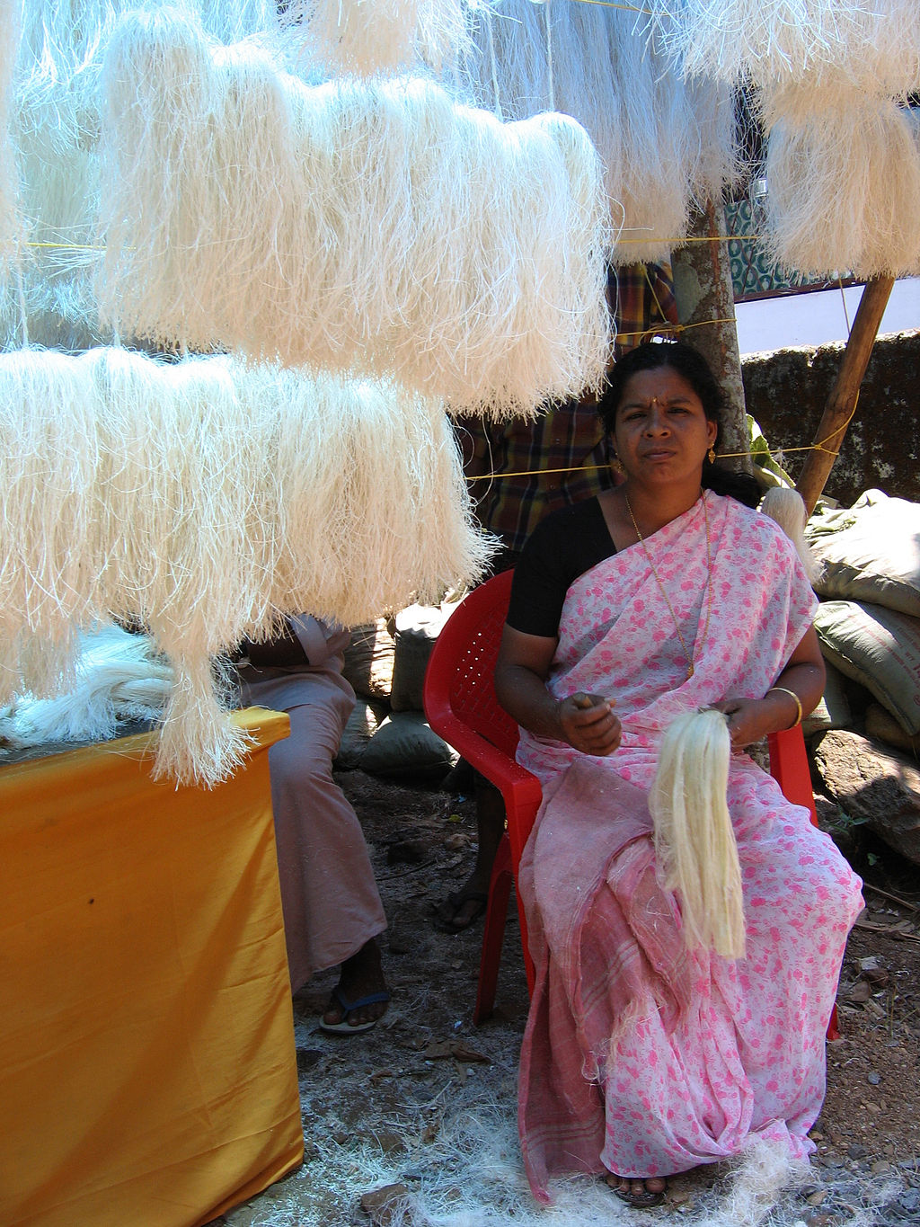
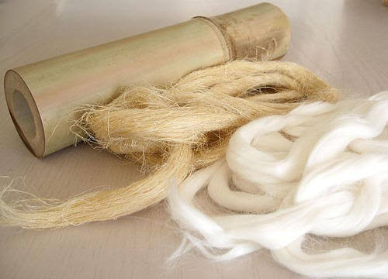
Bamboo Fibre Core Research
Processing, structure, mechanical properties of textile fibres
Split Yarn Technology of textile bamboo fibres
Optimizing raw bamboo textile fibres
Bamboo fibre cushions, sleeping mats & jeans
Strength & toughness at cellular level

Slide 20
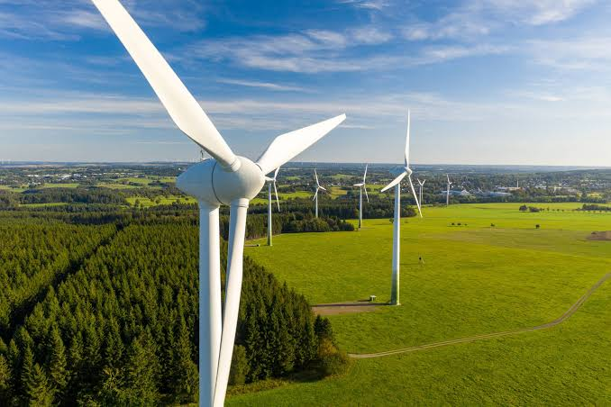
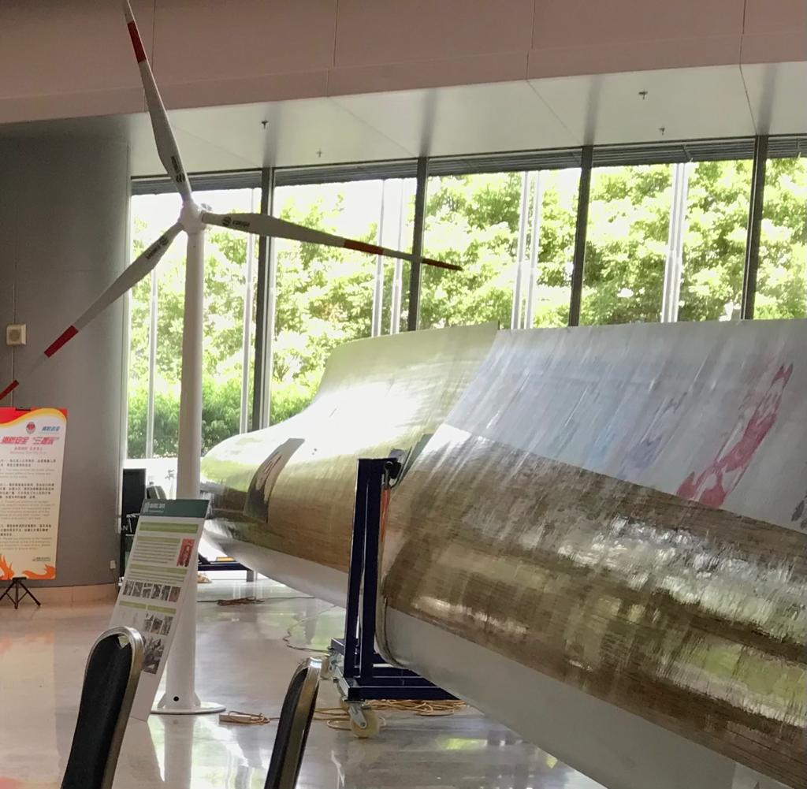
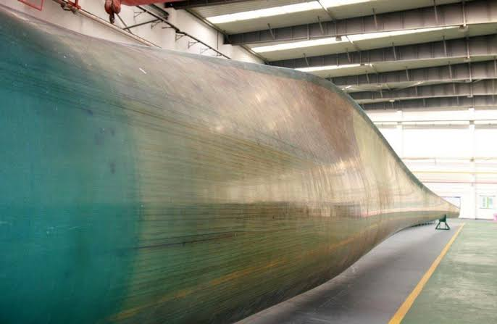
Bamboo Fibre Research
Short Fiber Composites
High-performance bamboo fibers for wind turbine blade
(40 mts.)
Micro-tensile high precision testing
Nanoindentation technology in bamboo science
5. Enhancement of bamboo utilization to 90%
6. Industrial upgradation & automation

Slide 21
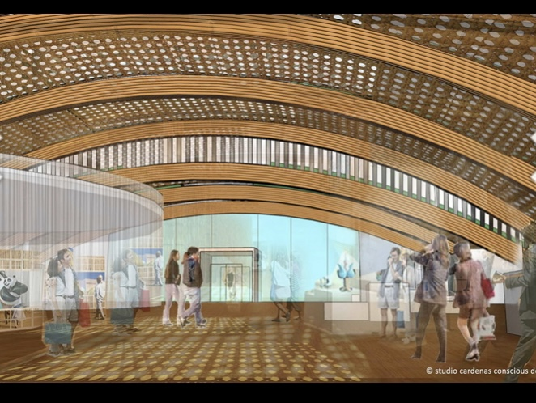
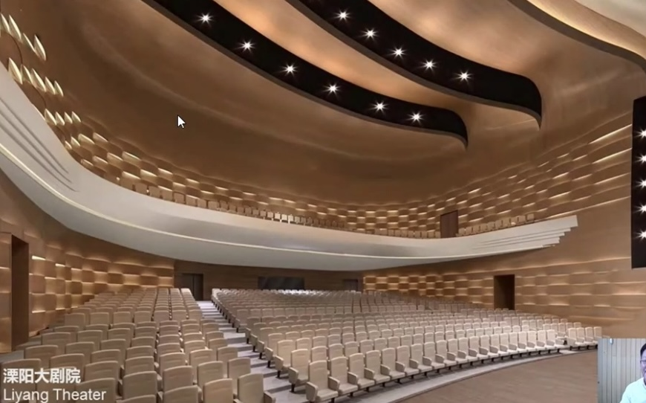
Bamboo Processing
Bamboo wood hybrid laminated composites
Bamboo bundle laminated veneer lumber (BLVL)
Bamboo modular wall panels
Long spanned bamboo beam for conference halls & luxury villas
Utilization in automobiles, drones, ultra-low temp
& high-pressure tanks, etc.

Slide 22
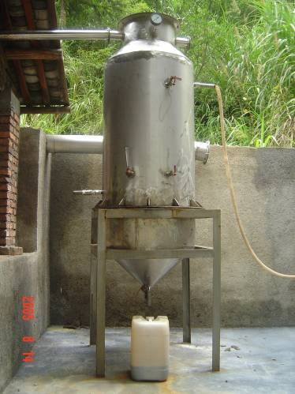
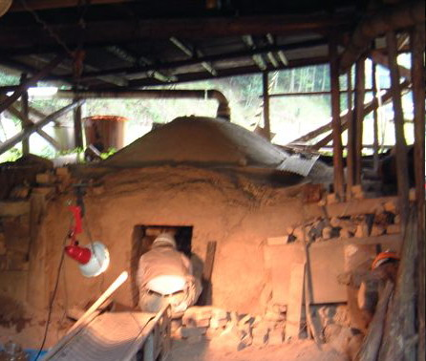
Bamboo Charcoal Research
Bamboo charcoal yield rate at different temperatures
Rules governing pH value & specific surface area
Deep processing technologies of bamboo charcoal & vinegar
Pyrolysis production technology & equipment
Pyrolysis-gasification-power generation charcoal
Bamboo vs wood charcoal, activated charcoal &
biochar-based fertilizer

Slide 23
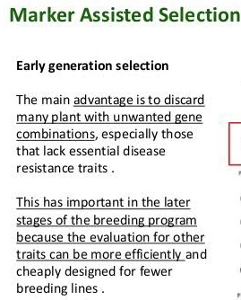
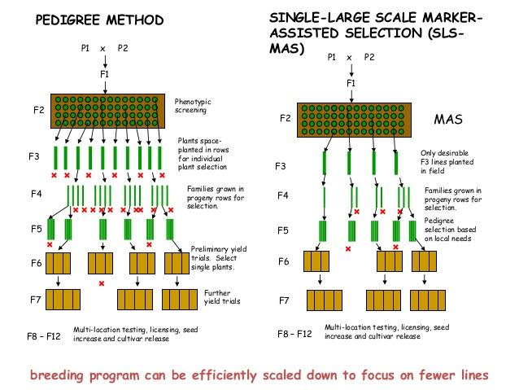
Bamboo Genetics
Functional genes of important bamboo traits
Genetic Information Analysis
Gene Functions
Genetic mysteries of bamboo growth & development
New species of bamboo to meet industrial parameters
Molecular marker-assisted bamboo breeding

Slide 24
Concluding remarks...
FOR HOLISTIC BAMBOO DEVELOPMENT:
VALORISATION, RIGHT POLICY FRAMEWORK, INSURANCE, FINANCE
& MARKETING SUPPORT
AGGRESSIVE PRODUCT PROMOTION: DOMESTIC AND EXPORT MARKET
BAMBOO INDUSTRY SAVES FOREST, HUGE EMPLOYMENT IN EACH VALUE CHAIN LINK
(E.g. Anji-Lin’an, China & Yamunanagar-Gandhidham-Angamali, India)
GOVT. TO ENHANCE MARKET DEMAND
BAMBOO COMPOSITES ARE HAVING ALL POTENTIAL TO BECOME
THE WONDER MATERIAL OF 21ST CENTURY.

Slide 25
Thank You All
Email: bnmohanty86@gmail.com
+919449043115

